Slide 1

Employee Database (SQL and Tableau)
Rishab Kumar
30th August 2024

Slide 2
Database Schema Diagram
Department Employee
Employee Number (PK)
Department Number (PK)
From Date
To Date
Employees
Employee Number (PK)
Birth Date
First Name
Last Name
Gender
Hire Date
Salaries
Employee Number (PK)
Salary (UK)
From Date (PK)
To Date
Departments
Department Number (PK)
Department Name (UK)
Departments Manager
Employee Number (PK)
Department Number (PK)
From Date
To Date

Slide 3
Questions to Answer
Q1. Create a visualization that provides a breakdown between the male and female employees working in the company each year, starting from 1990.
Q2. Compare the number of male managers to the number of female managers from different departments for each year, starting from 1990.
Q3. Compare the average salary of female versus male employees in the entire company until year 2002, and add a filter allowing you to see that per each department.
Q4. Create an SQL stored procedure that will allow you to obtain the average male and female salary per department within a certain salary range. Let this range be defined by two values the user can insert when calling the procedure.

Slide 4
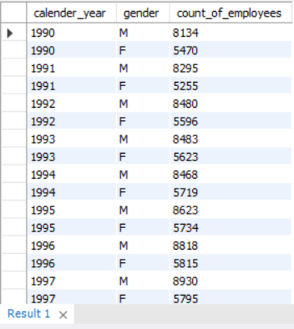
Task 1 Query
Q1. Create a visualization that provides a breakdown between the male and female employees working in the company each year, starting from 1990.
Query
Output
SELECT
YEAR(d.from_date) AS calender_year,
e.gender,
COUNT(e.emp_no) AS count_of_employees
FROM
t_employees e
JOIN
t_dept_emp d ON e.emp_no = d.emp_no
WHERE
d.from_date >= '1990-01-01’
GROUP BY calender_year , e.gender
ORDER BY calender_year;

Slide 5
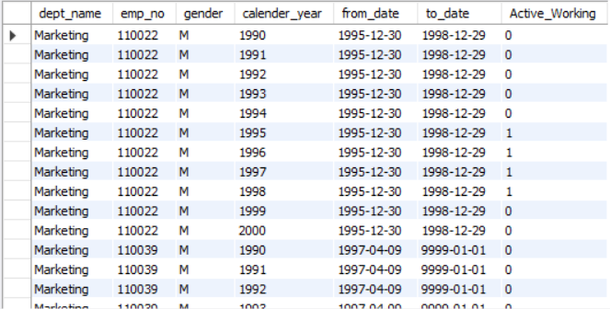
Task 2 Query
Q2. Compare the number of male managers to the number of female managers from different departments for each year, starting from 1990.
Query
Output
SELECT
d.dept_name, de.emp_no, ee.gender,
e.calender_year, de.from_date, de.to_date,
(CASE
WHEN e.calender_year BETWEEN YEAR (de.from_date) AND
YEAR (de.to_date) THEN 1
ELSE 0 END) AS Active_Working
FROM
(SELECT YEAR(hire_date) AS calender_year
FROM t_employees
GROUP BY calender_year) AS e
CROSS JOIN t_dept_manager de
JOIN t_departments d ON de.dept_no = d.dept_no
JOIN t_employees ee ON ee.emp_no = de.emp_no
ORDER BY de.emp_no , e.calender_year;

Slide 6
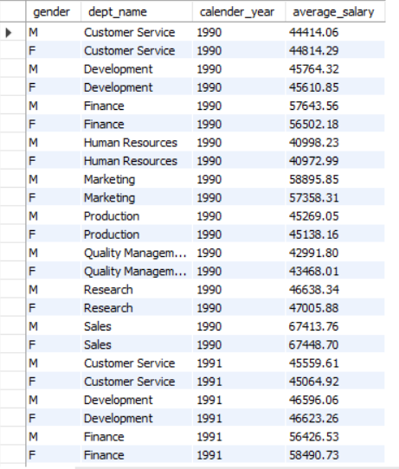
Task 3 Query
Q3. Compare the average salary of female versus male employees in the entire company until year 2002, and add a filter allowing you to see that per each department.
Query
Output
SELECT
e.gender, d.dept_name, YEAR(s.from_date) calender_year, ROUND(AVG(s.salary), 2) AS average_salary
FROM t_salaries s
JOIN
t_employees e ON e.emp_no = s.emp_no
JOIN
t_dept_emp de ON e.emp_no = de.emp_no
JOIN
t_departments d ON d.dept_no = de.dept_no
WHERE YEAR(s.from_date) <= '2002’
GROUP BY gender , dept_name , calender_year
ORDER BY gender , dept_name , calender_year;

Slide 7
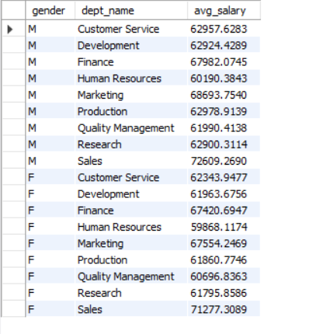
Task 4 Query
Q4. Create an SQL stored procedure that will allow you to obtain the average male and female salary per department within a certain salary range. Let this range be defined by two values the user can insert when calling the procedure.
Query
Output
DELIMITER $$
CREATE PROCEDURE a_salary (IN max_salary FLOAT, IN min_salary FLOAT)
BEGIN
SELECT e.gender, d.dept_name, AVG(s.salary) AS avg_salary
FROM t_employees e
JOIN
t_salaries s ON s.emp_no = e.emp_no
JOIN
t_dept_emp de ON de.emp_no = e.emp_no
JOIN
t_departments d ON d.dept_no = de.dept_no

Slide 8
Task 4 Query
Q4. Compare the average salary of female versus male employees in the entire company until year 2002, and add a filter allowing you to see that per each department.
Query (Continue…)
Output
WHERE
s.salary BETWEEN min_salary AND max_salary
GROUP BY e.gender , d.dept_name
ORDER BY d.dept_name,e.gender,avg_salary;
END$$
DELIMITER ;
CALL employees_mod.a_salary(90000, 50000);

Slide 9
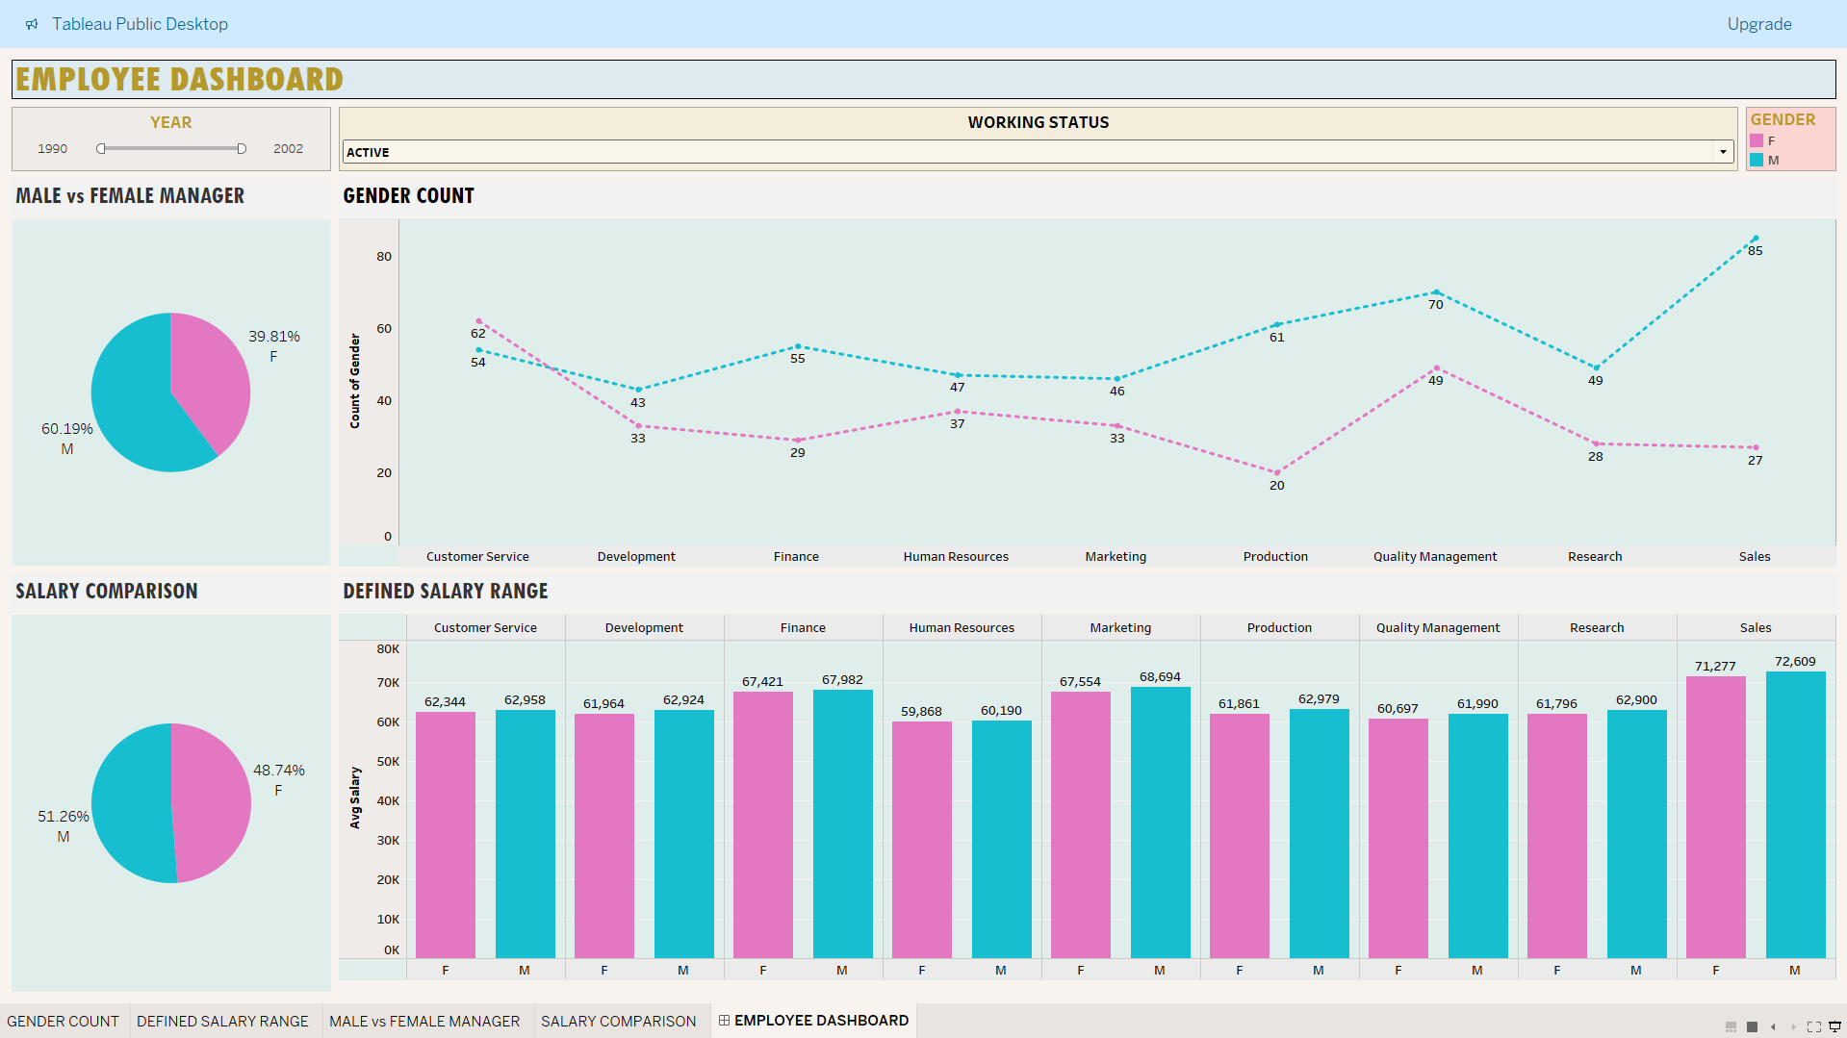
Tableau Dashboard

Slide 10
Key Statements/Clauses Covered
- Select Statement
- Case Statement
- And Statement
- Year Function
- Join Statement
- Where Clause
- Order Clause
- As Command (Alias)

Slide 11
Key Statements/Clauses Covered
- Subqueries
- Procedures

